Slide 1
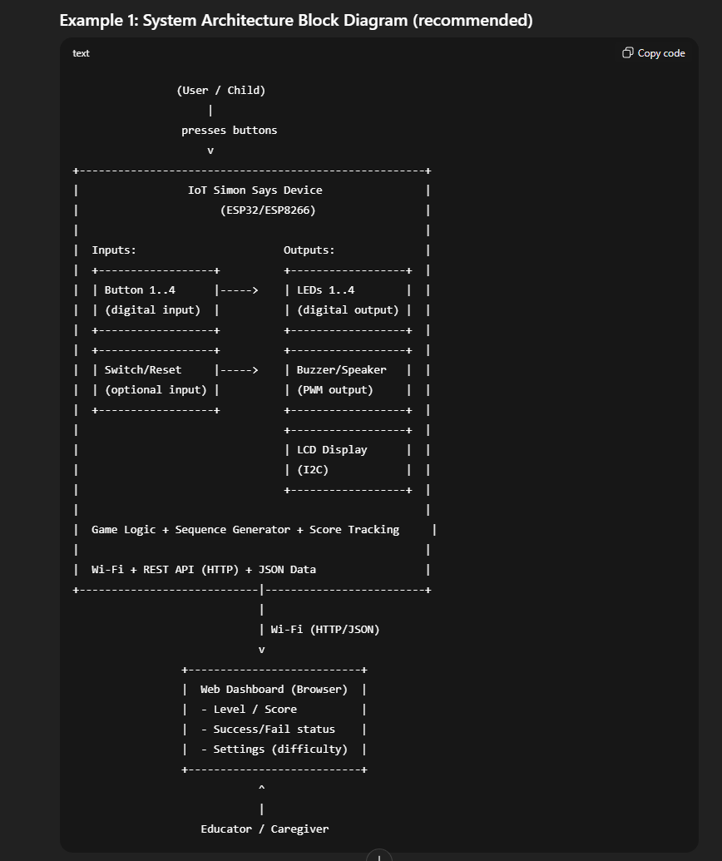
Proposed Project System Architecture
ESP8266 Microcontroller
Inputs:
Outputs:
HTML Web Server (browser)
Red Button
Green Button
Yellow Button
Blue Button
Reset/Start Button
LCD Display (I2C)
Buzzer/Speaker
Level/Score
Settings (difficulty)
Time Taken
Sequence used
LED Lights
Red Led
Green Led
Yellow Led
Blue Led
Wi-fi (HTTP REST JSON)
Code:
Game logic
Sequence Generator
Score tracking

Slide 2
State Diagram
Start
Idle state
Play Sequence State
Transfers score and data to web server
User Input State
Game over state
Sequence increased by 1
No
Correct Sequence entered by user?
Is retry count more than 0?
Yes
No
Yes

Slide 3
System Architecture Diagram
Device layer
Network layer
Application Layer
Inputs:
Outputs:
HTML Web Server (browser)
Red Button
Green Button
Yellow Button
Blue Button
Reset/Start Button
LCD Display (I2C)
Buzzer/Speaker
LED Lights
Red Led
Green Led
Yellow Led
Blue Led
Level/Score
Settings (difficulty)
Time Taken
Sequence used
Wi-fi
(HTTP REST JSON)
Code:
Game logic
Sequence Generator
Score tracking
Retry tracking
Node Red Dashboard
Firmware:
Level/Score
Settings (difficulty)
Time Taken
Sequence used
Arduino
Node Red
Painlessmesh
Over the air (OTA) updates

Slide 4
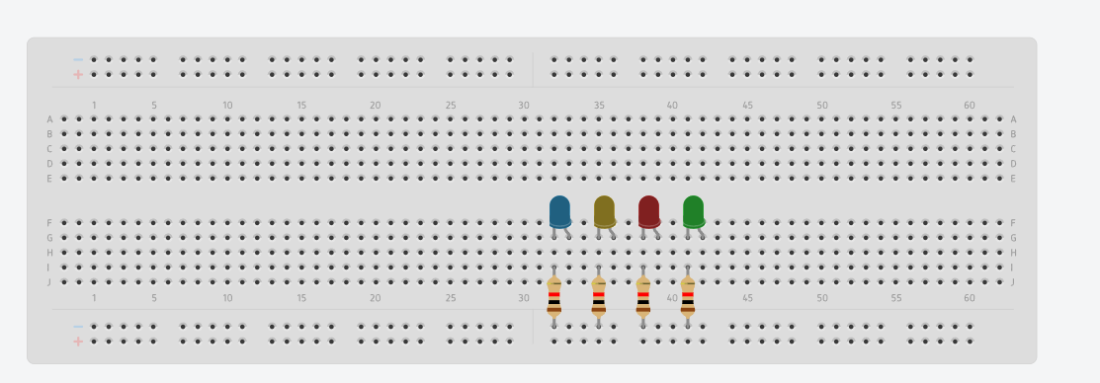
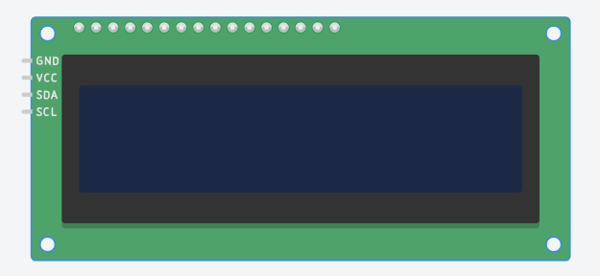
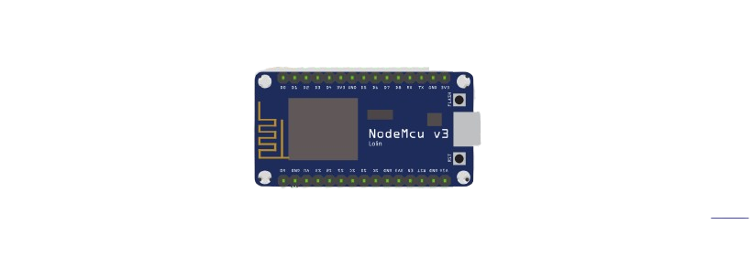
Board 1

Slide 5
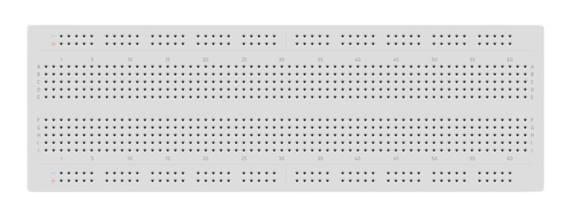
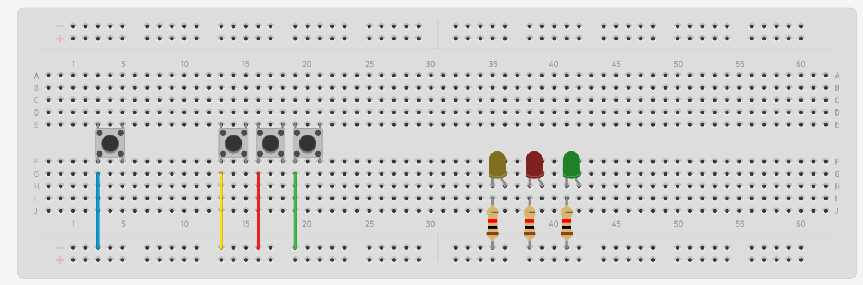
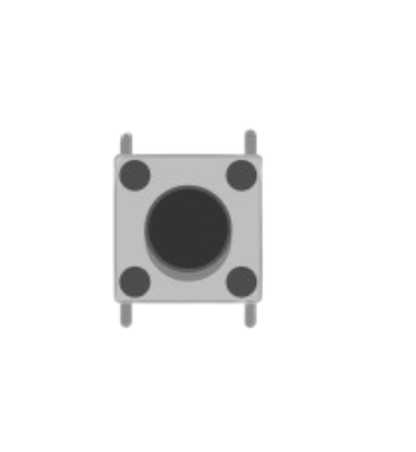
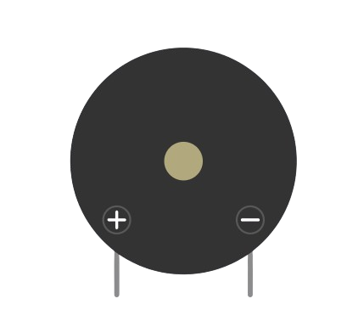
Board 2

Slide 6
Data flow Diagram
Dashboards
Board 2
Mesh Requests
PRESS:x
START
Board 1
HTTP REST JSON
GET /status
GET /runs
(HTML & Node Red)
Game engine
LEDs
LCD
Game State
Difficulty
Current Level
Top Score
Current Sequence
Run Active
Buttons
Buzzer
Mesh Responses
OK, WRONG , ROUND, GAMEOVER
Commands
GET /start
GET /reset
WiFi Mesh (PainlessMesh Protocol)

